Slide 2

Major Project 2 Title: IMAGE ENCRYPTION USING DNA ENCODING Submitted By: Kathir Sudan( R134218080) Ankur Vijayvargiya(R134218023) Anish Bansal(R134218020) Abhay Jhouta(R134218002) Under the guidance of: Dr. Manoj Kumar School of Computer Science and Engineering

Slide 3
Image Encryption Techniques
There are symmetric and asymmetric techniques for data encryption.
But in image encryption, asymmetric encryption techniques may become more complex due to the public-private key combination. Therefore, symmetric encryption techniques are more commonly used in image encryption.
This method required a random sequence of key and the chaotic function is very useful for generating the random sequence.
These chaotic function can be combined with DNA sequence to get better encryption to image

Slide 4
Need Of Image Encryption
Nowadays, the internet becomes very popular for transmitting the information. A large number of digital images are being transmitted on the internet every day.
Sometimes these images might contain some secret information. So these images should be protected from attackers.
In order to secure digital images, we need image encryption.
Image encryption is based on the idea of taking consecutive or random pixels of an image and by applying some logic we can convert them into a new set of pixels.

Slide 5
DNA Encoding
DNA sequencing is the process of determining the sequence of nucleic acids or the sequence of nucleotides in DNA.
Adenine, Guanine, Cytosine and thymine are four bases of DNA. Basically, they are building blocks of DNA. Adenine binds with Thymine and Guanine bind with Cytosine. Therefore Adenine is complement to Thymine and Guanine is complement to Cytosine.
In binary, 0 and 1 complement each other, so 00 and 11 are complementary to each other, 01 and 10 are also complementary to each other. Here, we represent A, T, G and C with 00, 11, 01 and 10 respectively.
Every image in the digital world can be represented by 8-bit binary numbers. We can convert an image into string of nucleotides. For example 11100001 can be written as TCAG.

Slide 6
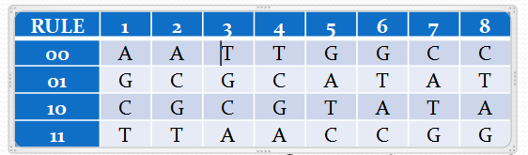
DNA Encoding
There are 24 types of combinations of these four nucleotides. However, only eight coding combinations are applicable for the principle of complementarity.
We can use any rule for image encryption from above table.

Slide 7
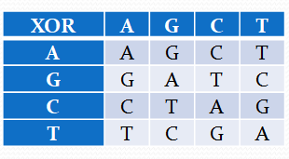
DNA Operations
There can be addition, subtraction, and XOR operations among the DNA nucleotides.
These operations produce the same results as those produced in their binary equivalent.
We have used DNA XOR operation for the encryption.

Slide 8
Chaotic Maps
Chaotic Maps are used to generate the pseudo-random sequence so that it can be used to confuse the pixels.
These functions take an initial value and then it generates the pseudo-random sequence which is very hard to analyze.
These initial conditions are very sensitive to changes. Any small change in the initial conditions will cause the trajectories to change so much, making it difficult to predict any outcome.
Without knowing the initial conditions of the system it is difficult to decrypt.

Slide 9
Chaotic Maps
The encryption methods of chaotic maps are divided into one-dimensional chaotic encryption and multi-dimensional chaotic encryption.
The one-dimensional chaotic map is easy to implement, has a simple structure, and the time required to generate a chaotic sequence is less. But it provide low security in comparison to higher-dimensional
Higher-dimensional chaotic maps provide a rich amount of randomness and a high level of security to the image. We have used 3-D Lorenz Logistic Map to generate the chaotic sequence

Slide 10
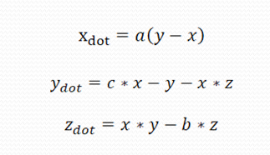
Lorenz Logistic Map
Lorenz logistic map is defined by non-linear system of ordinary differential equation:
where a, b, c are the control parameters while x, y, z are the state variables. , and xdot, ydot, zdot are the time derivatives of the state variables x, y and z respectively.

Slide 11
Lorenz Logistic Map
For the proposed image encryption algorithm, we have fixed value of a = 10, b = 2.667, c= 28. We will also generate initial variables using the original image. This should be kept secret because if someone knows these then encryption becomes weak.

Slide 12
Proposed Algorithm
We will generate a secret key by first condensing the given matrix into a 1-D array and then generating the 256 hash of the array using the SHA-256 algorithm which converts it into 256 bits code.
Now use this generated secret key to generate the initial values x_{o}, y_{o ,} and z_{o} for the chaotic map.
Split the original image into three different matrices of red, green, and blue. and convert these matrices into the binary matrix.
Encode these matrices into DNA sequence by using one of the rules for encoding.
01 10 11 01 C G T C
10 11 11 01 => G T T C
00 01 10 00 A C G A
01 01 10 10 C C G G

Slide 13
Proposed Algorithm
Now, we will convert the secret key generated in step 1 into 2-D matrix of size M X N. We converted the above generated matrix in binary form and DNA encode it.
Now perform the XOR operation between the each DNA encoded matrices and DNA encoded matrix key generated in previous step by using the XOR operation.
Generate three chaotic sequence such as X = {x1, x2, x3, . . . . . ., xk}; Y = {y1, y2, y3, . . . . . . yk} and Z = {z1, z2,z3, . . . . . ., zk},by using Lorenz 3-d chaotic map

Slide 14
Proposed Algorithm
Now we will shuffle the values of all three R, G, B matrices. For shuffling of R, G, and B matrices we will use sequence X, Y, and Z respectively.

Slide 15
Proposed Algorithm
Now convert all three DNA encode scrambled matrices it back into binary matrices and combine them for retrieve the encrypted image
Now for decryption of the image, the process is the inverse of the encryption process. The receiver will get the secret key from the sender which we have generated in step 1.

Slide 16
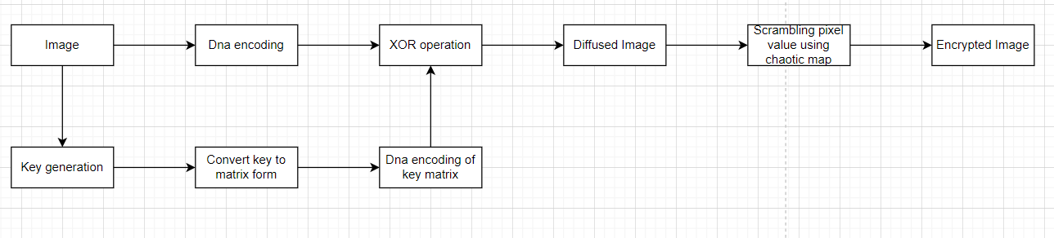
Flow chart

Slide 17
Experimental Results of algorithm

Slide 18
Algorithm Performance
Histogram Analysis
In this statistical analysis of the original and encrypted images, we construct the histogram of each color of the above displayed images (both original and encrypted). This show that histogram of encrypted and decrypted images are quite different which makes it more difficult to decrypt.

Slide 19
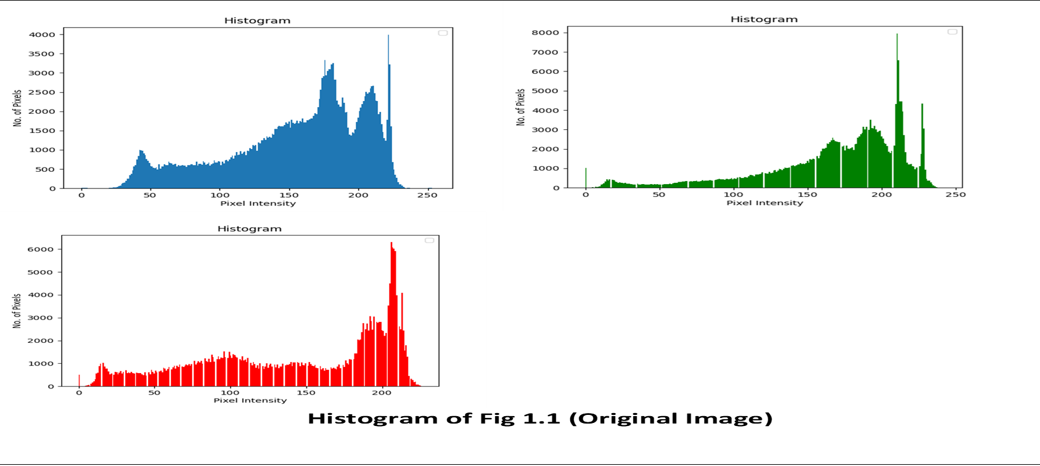

Slide 20
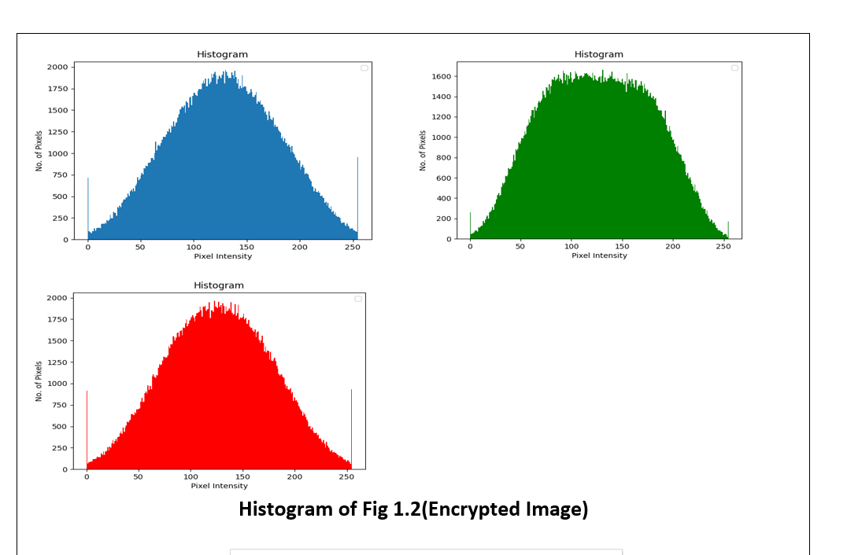

Slide 22
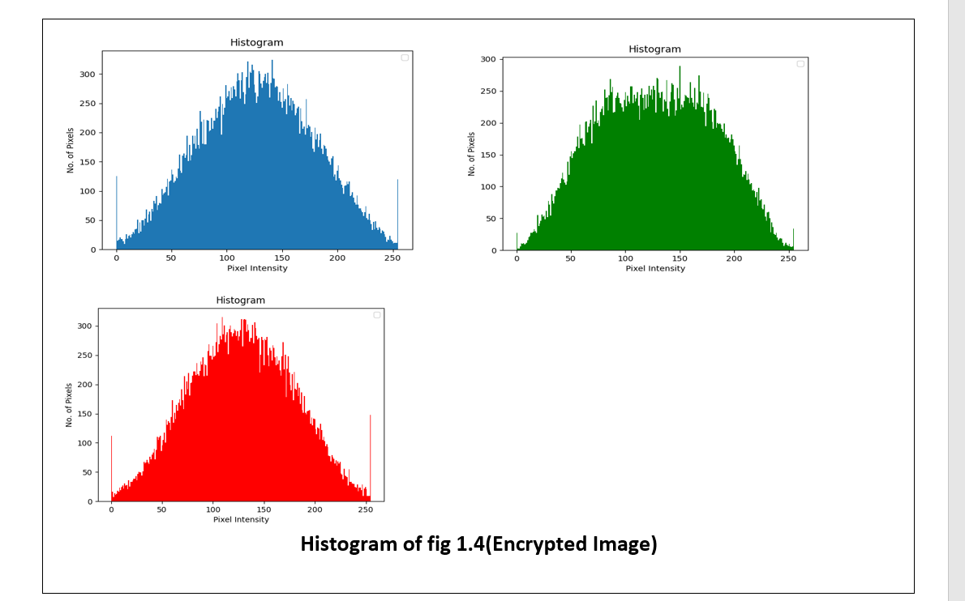

Slide 23
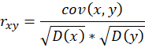
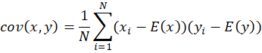
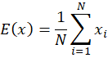
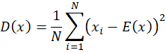
Performance of Algorithm
Correlation Coefficient
Correlation Coefficient is one of the ways that is used to find the degree of linear correlation between two random values.
For finding correlation coefficient, we will take pairs of adjacent pixels in all the three directions (horizontal, vertical and diagonal) for both encrypted and original image. Then we calculate the correlation coefficient using formulas given below:

Slide 24
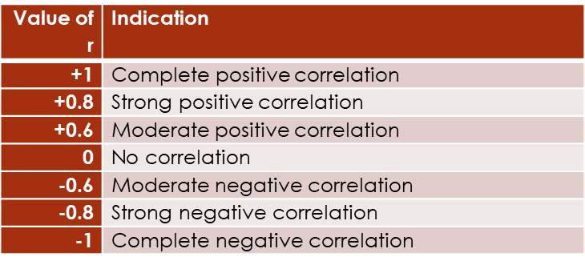
Performance of Algorithm
The value of the correlation coefficient r can vary from -1 to 1. r>0 indicated positive correlation while r<0 means negative correlation. Meaning for different values of r are given in the table

Slide 25
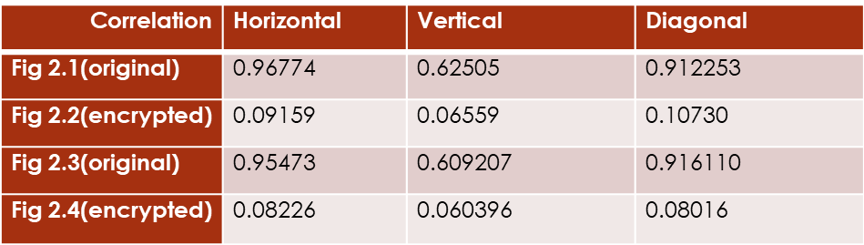
Performance of Algorithm
The results of correlation coefficients of both the images shown in table

Slide 26
Performance of Algorithm

Slide 27
Performance of Algorithm
Differential Attack
Attackers often make a slight change to the original image, and use the proposed algorithm to encrypt for the original image before and after changing, through comparing two encrypted image to find out the relationship between the original image and the encrypted image. It is called differential attack.
The image obtained after the encryption should be significantly different from the original image. This difference can be measured by two techniques namely NPCR and UACI.
NPCR is number of pixel changing rate. Basically, it is the change rate of the encrypted image pixels when the image changes one pixel in the process of encryption. The larger the value of NPCR is, the stronger the resistance is of the algorithm to plaintext attacks
UACI is unified averaged changed Intensity. Basically, it is the change rate of the average strength of the original image and the encrypted image. The smaller the value UACI is, the stronger the resistance is of the algorithm to differential attacks.

Slide 28
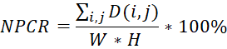
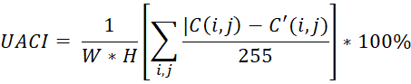
Performance of Algorithm
The formulas for calculating the values of NPCR and UACI are:
Where H and W represents the height and width of the image, respectively. C and C ’denote the encrypted images before and after one pixel of the image is changed. For the pixel at position (i,j ), if C (i,j ) !=C` (i,j ), let D(i,j ) = 1; else, let D(i,j ) = 0.

Slide 29

Performance of Algorithm
NPCR and UACI values For Algorithm are shown in the table

Slide 30
Conclusion
In this project, we have combined chaotic maps with DNA so that we can get better encryption. First, we generated a secret key by using the SHA-256 algorithm. Then, we shuffled the position of pixels by using chaotic maps. Then we encoded all pixels of the original image and the secret key into DNA sequences by converting all values into four DNA nucleotides. Next, we perform an XOR operation between DNA encoded pixels and DNA encoded secret key. Finally, we convert the resulted 2-d matrix back into binary form and get our encrypted image. Our experimental results show that our encryption is very good and very difficult to decode by any unauthorized person.

